Slide 1

IT SKILLS ASSESSMENT
IN ARMENIA
Prepared by EV Consulting
June, 2014
Yerevan

Slide 2
Overview of the sector
Demand side analysis of skills gap
Supply side analysis of skills gap
Recommendations

Slide 3
Overview of IT and High technology sectors in Armenia

Slide 4
IT and High technology sectors are one of the fastest growing sectors in the economy of Armenia.
Industry turnover, labor productivity and number of employees, 2006-2013
~3% of GDP
CAGR: 22%
~0.7% of total labor force
CAGR: 10%
~4x higher the average level of economy
CAGR: 9%

Slide 5
The number of companies operating in the sector has reached to about 380 in 2013 from 175 in 2008.
CAGR: 22%
CAGR: 20%
CAGR: 13%
IT companies
(87% of total number)
High-tech companies
(13% of total number)

Slide 6
The dynamic growth of the sector is marked with a number of significant developments
Trainings centers
Labs and technoparks
Multinationals
Entrepreneurial ecosystem
Microsoft innovation center
Armenian-Indian ICT Excellence Center
mLAB ECA
Instigate Training center, etc.
Armenian National Engineering Laboratory (ANEL)
Gyumri Information Technology Center
Oracle
IBM
Granatus Venture Fund I

Slide 7
The industry has two directions of sustaining its growth: maintaining the outsourcing capabilities and higher value added entrepreneurial model of growth.
Sector development
Outsourcing capabilities
Entrepreneurial/higher value added growth
Low-cost high-quality workforce
Innovation management, business acumen
Multinationals’ entrance
FDI
Venture capital
Scale-up to international markets

Slide 8
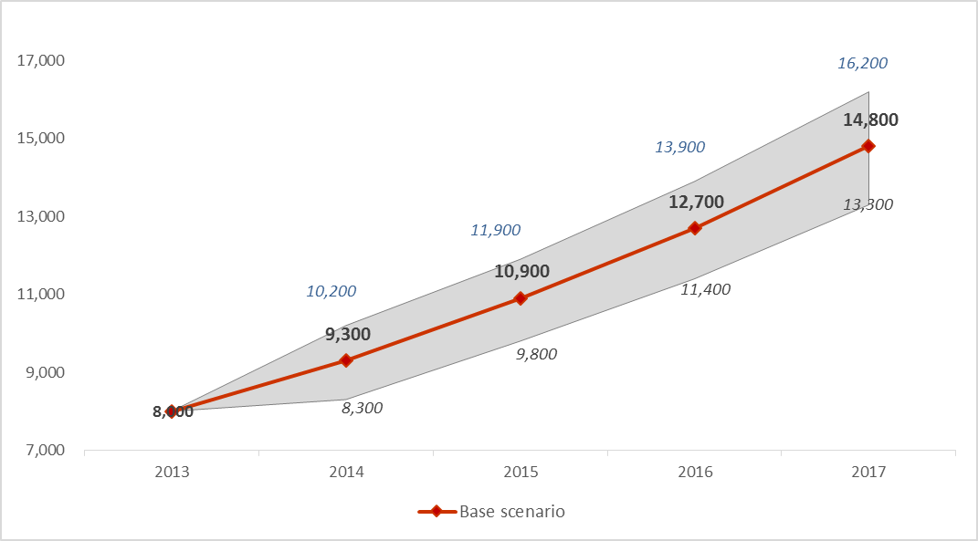
Due to growing number of IT companies in Armenia, demand in IT specialists will continue to increase.
The forecast of employee absorption potential in IT and High-tech sectors
Optimistic scenario
Assumptions
Market growth rate – 18%
Productivity growth rate – 1%
IT specialists absorption potential – 17%
Pessimistic scenario
Base scenario

Slide 9
Educational sector needs to quickly adapt and reflect these challenges in order to sustain the sector competitiveness.

Slide 10
Demand side analysis of skills gap in Armenian IT and High Technology sector

Slide 11
IT and High-technology companies view the mismatch between the supply and the demand of the skilled IT labor as a key factor that hinders the growth of the sector.
Qualitative skills gap
Quantitative skills gap
EMPLOYEE DEMAND
150 employees short-term (3 months)
600 employees long-term (3 years)

Slide 12
The demand for new talent in surveyed High technology companies is higher compared to IT companies.
Number of demanded IT specialists categorized by IT and High-tech sectors
High-tech
Short-term demand
Long-term demand

Slide 13
Software development will remain the most widespread and demanded specialization in the upcoming 3 years.
Number of required IT specialists categorized by specialization
Breakdown of short-term "Other" category
Breakdown of long-term "Other" category

Slide 14
The main constraint of recruitment for companies is the lack of qualified candidates in the market.
Recruitment constraints in IT and Engineering companies
Number of respondents: 29

Slide 15
The migration trend severely impacts the pool of available IT specialists in Armenia.
IT specialists in Armenia
Impactful, creative and global career seekers
Higher compensation seeker with strong personal ties with the country
Leave the country

Slide 16
The local small companies with revenue limitations face intensifying competition in hiring local talent, due to high remuneration levels.

Slide 17
The quality gap of the skills in IT and High tech is due to low quality of graduates according to the sector companies.
Assessment of skills for graduates in IT and Engineering sectors by companies
Number of respondents: 29
Practical capabilities are below expectation - ~73% respondents
Theoretical knowledge level is average or below – ~80% respondents

Slide 18
Soft skills and English knowledge of the graduates are on a more acceptable level compared with theoretical and practical knowledge.
Assessment of skills for graduates in IT and Engineering sectors by companies
Practical knowledge
Number of respondents: 29
Soft skills are average or above - ~70% respondents
English language skills are average or above – ~80% respondents

Slide 19
Importance of soft skills and fluency in language are crucial for the employers.
Assessment of soft skill importance of job candidates
Share of English-speaking employees in surveyed IT companies
Number of respondents: 28
Number of respondents: 29

Slide 20
Companies adjust their recruiting requirements and lower standards due to the lack of qualified candidates.
Current company preference for different candidate skills and knowledge and other characteristics
Number of respondents: 28

Slide 21
The university degree is not a crucial decision factor in recruitment by companies, indicating the diminishing role and image of higher education in the sector due to the insufficient quality of graduates.

Slide 22
Only 8% of surveyed companies considered the university degree to be of high-level importance for the recruitment process.

Slide 23
Currently, companies consider the Master’s degrees to have a limited benefit on top of knowledge gained through undergraduate studies.
The current structure of labor force in the sector by university degrees

Slide 24
Ability to independently find relevant information, utilize it is a critical requirement and self-educate is currently missing in the majority of graduates.

Slide 25
The companies do not differentiate among the faculties and major specializations of the higher education institutions.
Companies' preference for the major or discipline of graduates
Number of respondents: 29

Slide 26
About 34% of the respondent companies expressed no preference in hiring graduates from particular university.
Company preference for recruiting from Armenian universities
Number of respondents: 28

Slide 27
Supply side analysis of skills gap in Armenian IT and High Technology sector

Slide 28
The higher education system in Armenia lacks the competitive dynamism and efficiency.
Despite the existence of 63 public and private players, the sector lacks an efficient competitive environment:
State universities are privileged - providing substantial tuition subsidies and exemptions from army service for students.
Armenia is not big enough to afford several universities competing in each discipline so a few have become monopoly providers of education in certain disciplines.
Five universities dominate the sector by virtue of their scale of enrollment.
Armenian higher educational institutions do not track their performances by international rankings, the statistics on the career development of the graduates, etc.
The minimal connection with the global education market means the local market is a captive one.

Slide 29
The quest to join European Higher Education Area pressures Armenia to reform, but the pace is still unsatisfactory
WEF ranking on the Quality of Educational System, 2013-2014, Score, out of 7
WEF ranking on the Quality of Math and Science Education, 2013-2014, Score, out of 7

Slide 30
The list of most significant higher education institutions that provide IT and Engineering specializations comprise 5 universities.
State Engineering University of Armenia (SEUA)
Yerevan State University (YSU)
Russian-Armenian (Slavonic) University (RAU)
American University of Armenia (AUA)
European Regional Academy (ERA)

Slide 31
For the last 4 years there was no shortage in number of graduates enrolled in IT-related faculties.
Number of IT-related students and graduates

Slide 32
Provided the same tendency of faculty choice, the number of IT graduates will decrease starting from 2014/15 until 2022, with a slight recovery in 2016-2017.
Estimated number of graduates from IT-related faculties, 2013/14-2015/16
Graduates in IT-related specializations
Number of IT specialists required (base scenario)
Assumption
95% of currently enrolled students will graduate.

Slide 33
In 2018/19 and 2019/20 the number of the graduates is again expected to diminish due to the recent military reform owing to which males are bound to have a 2-year military service deferring their higher education.

Slide 34
Currently, there is a shortage of graduates in quantitative terms “produced” by the local higher education system, particularly, for the sector of IT and Engineering.
Number of IT and Engineering students and graduates in the universities, 2013/2014
 | YSU | SEUA | AUA | RAU | ERA
IT students | 670 | 1,650 | 100 | 200 | 90
Engineering students | 1,390 | 1,730 | 50 | 100 | 40
Total students | 2,060 | 3,380 | 150 | 300 | 130
IT graduates | 190 | 460 | 25 | 40 | 30
Engineering graduates | 480 | 640 | 25 | 20 | 10
Total graduates | 670 | 1,100 | 50 | 60 | 40

Slide 35
There is no quantity shortage of teaching staff in IT-related faculties in Armenian universities.
Number of teaching staff in universities by IT and Engineering specializations, 2013/2014

Slide 36
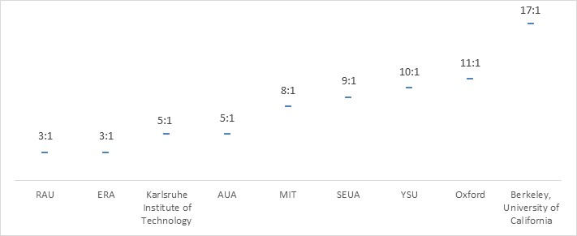
The average student-teacher ratios in Armenian universities are quite low compared to international standards, but teaching stuff is gradually aging.
Student-to-faculty ratio in local and Western Universities, 2014
Average age of the university lecturers, 2014
 | YSU | SEUA | AUA | RAU | ERA
Average age | 50 | 56 | 45 | ~45 | ~40

Slide 37
There is no set process between universities and companies in terms of organizing internship projects for students, yet there are discussions to make the internships of students an efficient link between the platforms.

Slide 38
Career centers can also serve as a link between universities and the private sector. However, these currently do not operate efficiently and are in their infancy stage.

Slide 39
IT training center services have significant demand from both the students and junior level working professionals.
Characteristics and indicators training centers in Armenia
 | Microsoft Innovation Center | Armenian-Indian IT Excellence Center | MLAB ECA
Technical courses | Available | Available | Available
Non-technical development courses | Available | Available | Available
Prerequisites | Basic knowledge and algorithmic thinking | No requirements for beginners, minimum test score/ knowledge for advanced stages | Basic programming knowledge required for transferring to mobile programming platforms
Annual number of graduates | ~1,000 | ~500 | ~300
Number of instructors | 9 | 10 | ~50
Average age of instructors | ~27 | ~40 | ~33-35
Internship | Available | Not available | Not available
Employability rate | 80%-90% | N/A | 90%

Slide 40
Engineering educational centers prepare specialists that meet international quality standards and are almost 100% employed.
 | Instigate Training Center | Synopsys Armenia Educational Department
Technical courses | Available | Available
Non-technical development courses | Not available | Available
Prerequisites | Capacity to solve technical problems, basic mathematical knowledge | Strong technical knowledge and algorithmic thinking. Strong knowledge of all technical fundamentals
Annual number of graduates | ~50 | ~80
Number of instructors | ~30 | 67
Average age of instructors | ~30 | ~30-35
Internship | Involvement in company projects | Involvement in company projects
Employability rate | 100% | 100%

Slide 41
There is total absence of professional off-job training program for senior developers on the market, so the companies have no alternative but to provide on-the-job training.

Slide 42
SUMMARY AND HIGH LEVEL RECOMMENDATIONS

Slide 43
Only 45% of the graduates consider employment in the sector, thus, creating a quantitative imbalance of workforce.
~450 graduates
~2,000 new specialists demanded
IT and High technology sector
Whereas, the number of graduates with IT specializations annually about coincides with the annual new demand in the overall market

Slide 44
Due to the fast growing industry dynamics there is also a qualitative skills gap
Teaching programs are not fit for the private sector standards
No effective links between university and private sector
Professional standards in teaching staff is low and there is no motivation to requalify
Teaching staff is aging
The university programs do not accentuate self-development
The university degree program is too long in comparison with the industry dynamics
Not sufficient number of high-level training programs for base and senior level specialists to requalify

Slide 45
High-level SHORT-TERM recommendations and key points for policy makers
A new university curriculum should be developed together with the private sector
The quota of government funded students should be increased for IT specializations
The link between the universities and private sector should be strengthened through transforming the role of mandatory internship/apprenticeship programs.
More young professionals should be encouraged to teach to inject the practical skills.

Slide 46
High-level SHORT-TERM recommendations and key points for policy makers
The need in base and senior level specialists can be satisfied via creation of special training programs.
Co-financing schemes for workforce development by means of training centers creation can help smaller companies to close the skill gap.
Widespread and targeted communication campaigns shall be organized to highlight the prospects and strong market demand for the engineering profession.

Slide 47
High-level LONG-TERM recommendations and key points for policy makers
The fundamental reshape of the IT education is recommended to start with the intervention at schools.
Simultaneously, the university funding needs considerable increase as well as diversification through research grants and endowment foundations.
The number of university-based laboratories, which are established with the help of multinationals, should be scaled up.
Creating an alternative program to prepare software programmers in less than 4 years will help increase the supply of labor in the medium term.

Slide 48
High-level LONG-TERM recommendations and key points for policy makers
The universities should transform their career centers into modern support mechanism for their graduates.
If Armenia aspires to transition from outsourcing, development center destination to one of innovation centers functioning under entrepreneurship model, it has to integrate fundamental, hard-core research into its university system.
High tech accelerators can become the new type of schools for entrepreneurs.

