Slide 1
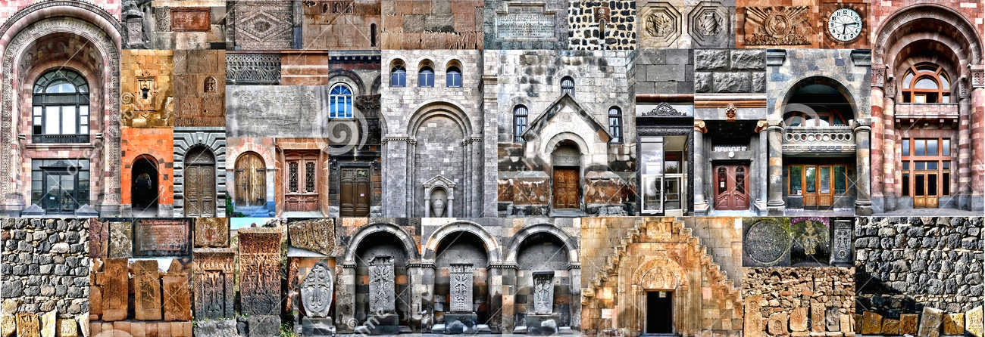



EIC: Lessons Learned
2011-2016
Between History and Technology

Slide 2
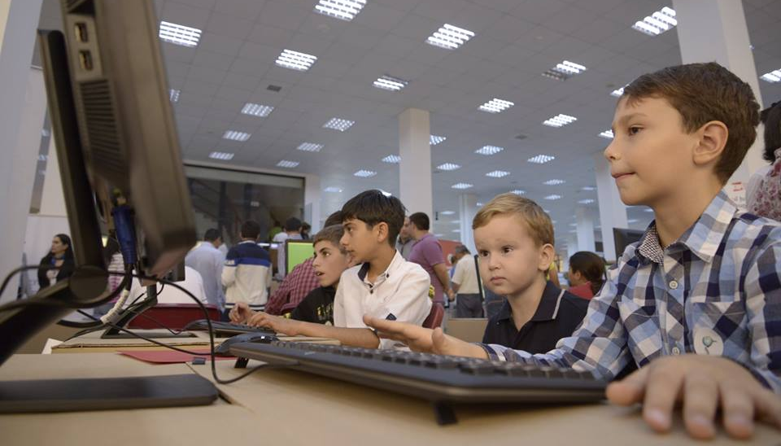
1
E-Society

Slide 3
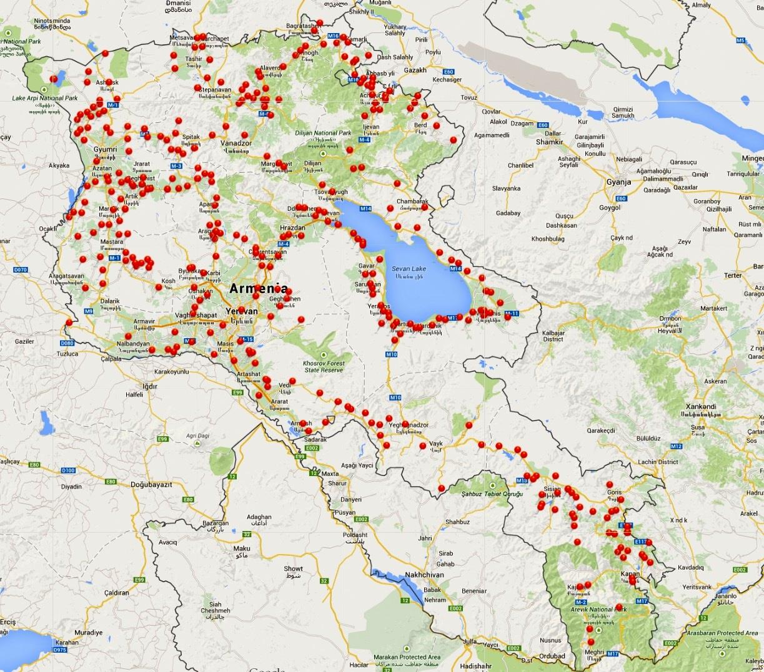
WIFI
344 villages have free internet access
UCOM continues the started program by becoming the internet service provider for those villages
VANADZOR TECHNOLOGY CENTER
>40 companies received business development consultancy
>25 teams received Assistance in Establishment of startup technological teams
> 600 beneficiaries were involved in the training programs conducted at VTC

Slide 4
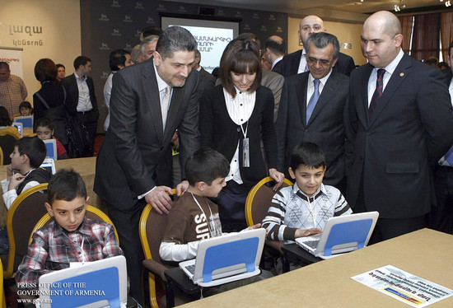
E-SOCEITY
100% occupancy rate with local and international companies
>2000 people trained in GTC
>50 companies received business development consultancy
Laboratories in filed of Engineering, CleanTech & Multimedia
COMPUTER FOR ALL
Successful mechanism for loan provision
Currently, a revolving fund by GAF
Replicated by other banks as a successful model

Slide 5
2
Financial
Mechanisms

Slide 6
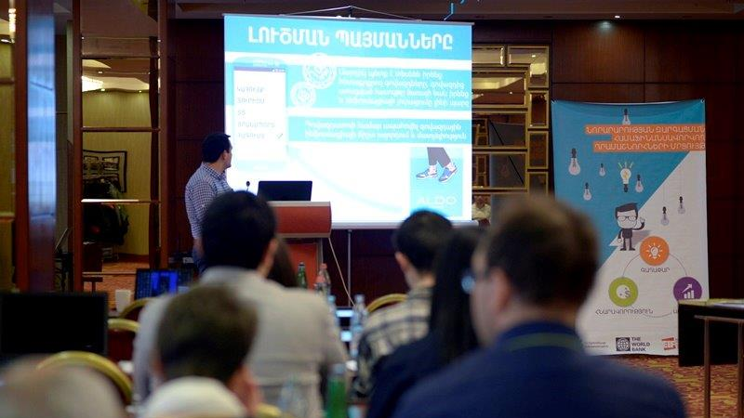
2
Financial Mechanisms
INNOVATION MATCHING GRANTS
33 new products/services developed
10 companies have generated revenue from the sale
>150 new jobs created in IT /Engineering sector
>20 new companies registered in Yerevan, Gyumri and Vanadzor.
> $1mln USD investment from venture funds, angle investors and other funds was attracted by the startup companies

Slide 7
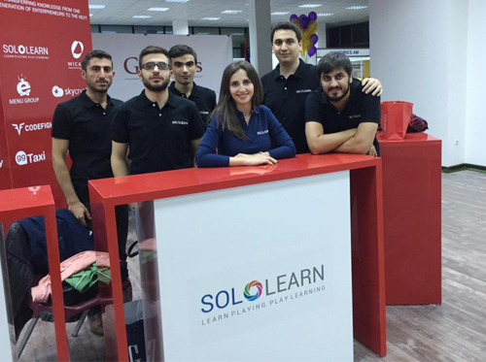
VENTURE FUND
11 investments have been made
6 companies have generated revenue
>70 new jobs created in IT/Engineering sector sector
>2000 new jobs created in other sectors
> $15mln USD funding raised globally

Slide 8
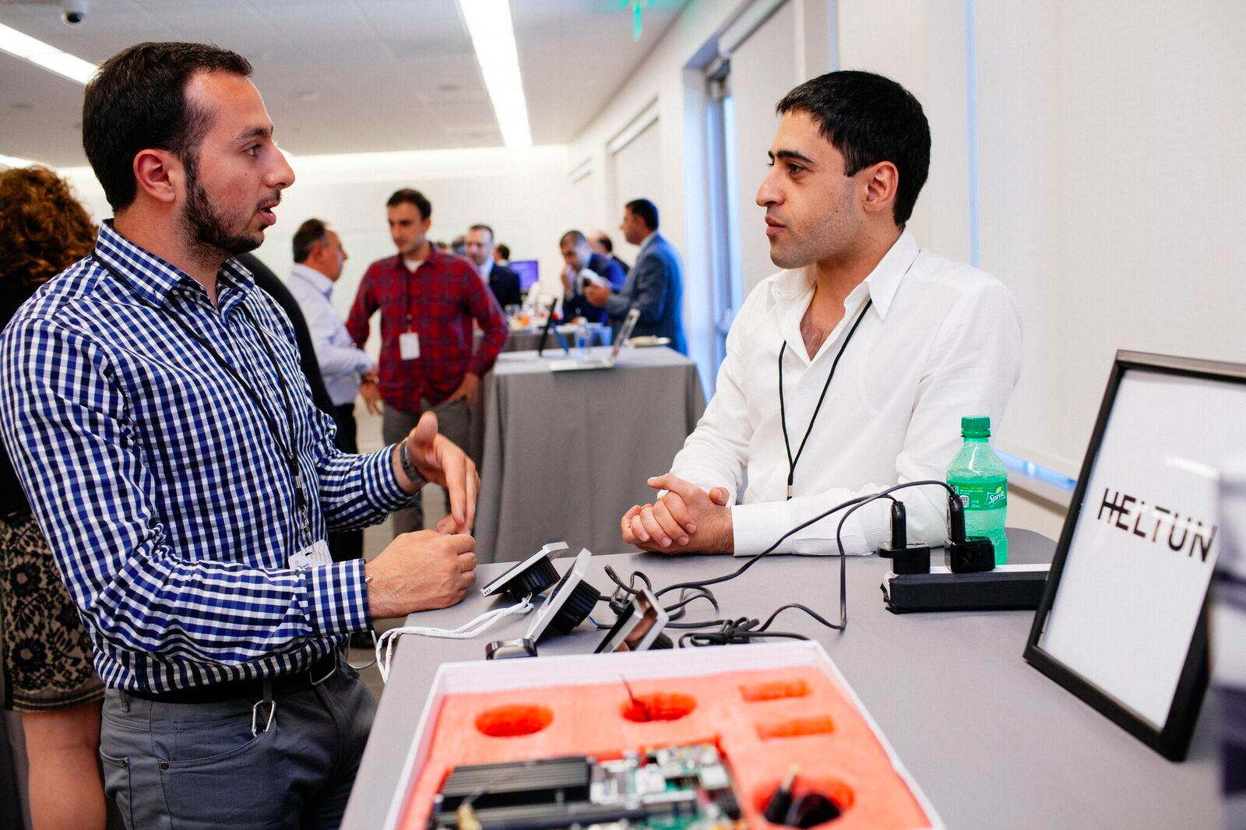
ARMENIA IT REPRESENTATION IN US
> 30 startups mentored
> 10 startups provided extensive mentorship by US mentors
5 startups presented to the potential US investors

Slide 9
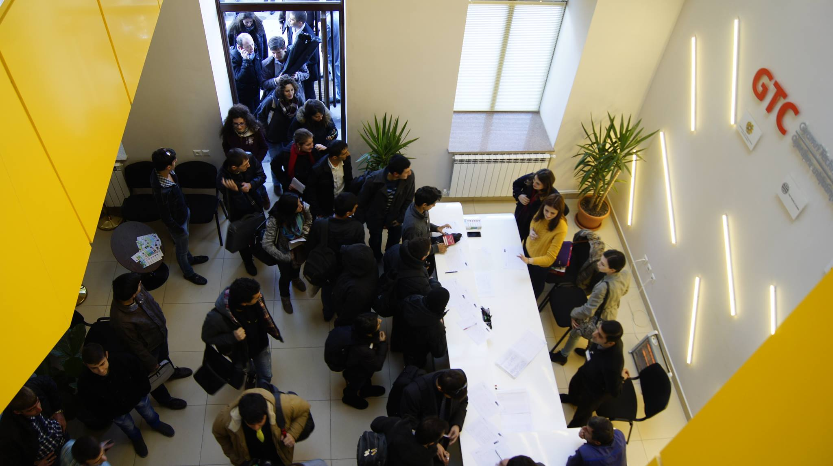
3
Regional Development

Slide 10
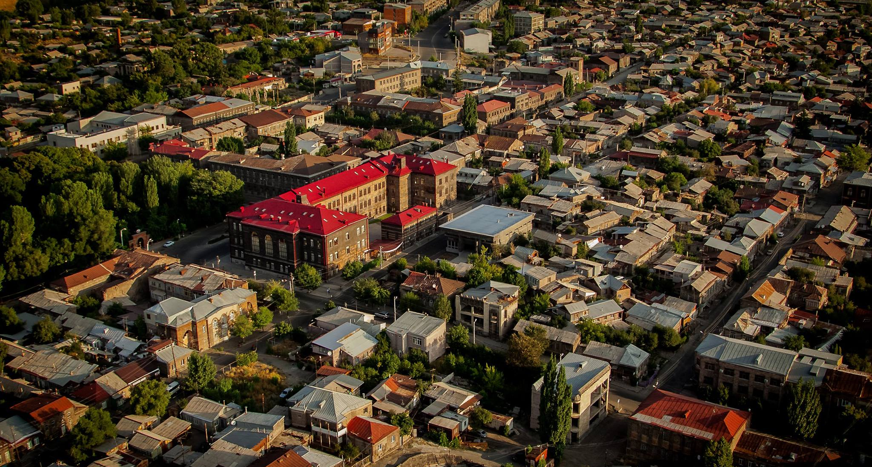
WiFi free internet access devices installed in 344 rural areas with up to 1,000 residents
- UCOM continues the started program
Computer for All mechanism is still operating through the revolving fund.
- Model replicated by the many Banks.
GYUMRI TECHNOLOGY CENTER
100% occupancy rate with local and international companies
>2000 people trained in GTC
>50 companies received business development consultancy
Laboratories in filed of Engineering, CleanTech & Multimedia

Slide 11
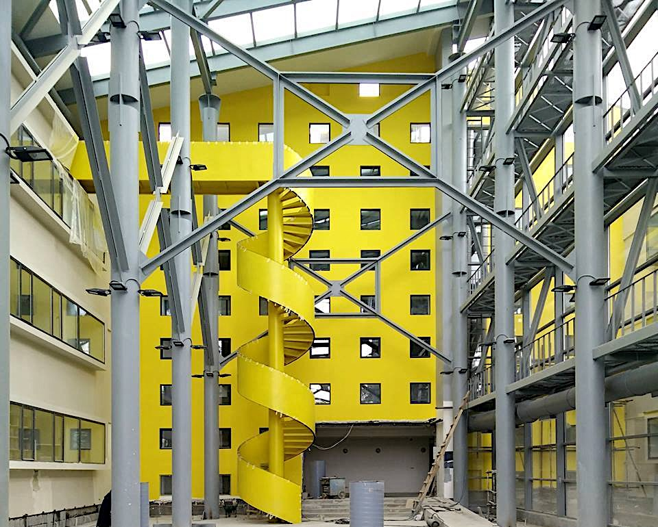
VANADZOR TECHNOLOGY CENTER
>40 companies received business development consultancy
>25 teams received Assistance in Establishment of startup technological teams
> 600 beneficiaries were involved in the training programs conducted at VTC

Slide 12
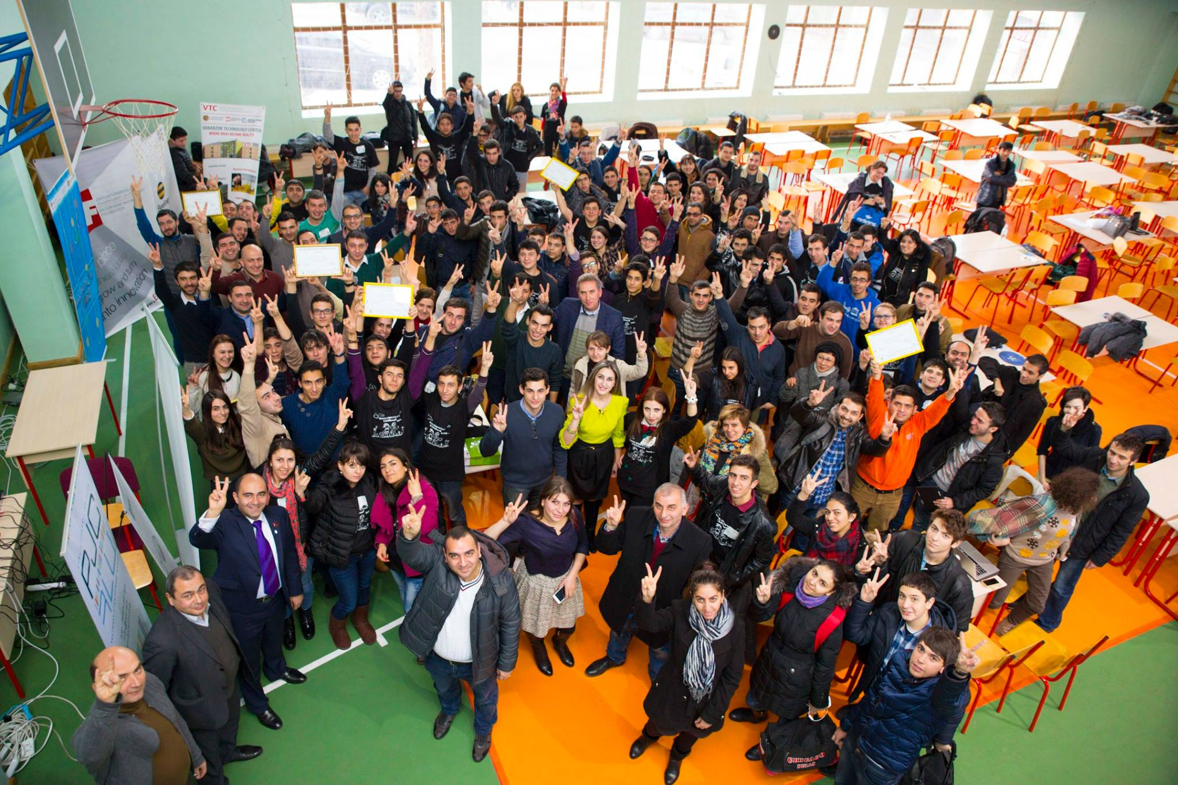
4
Innovation Centers/Skills development

Slide 13
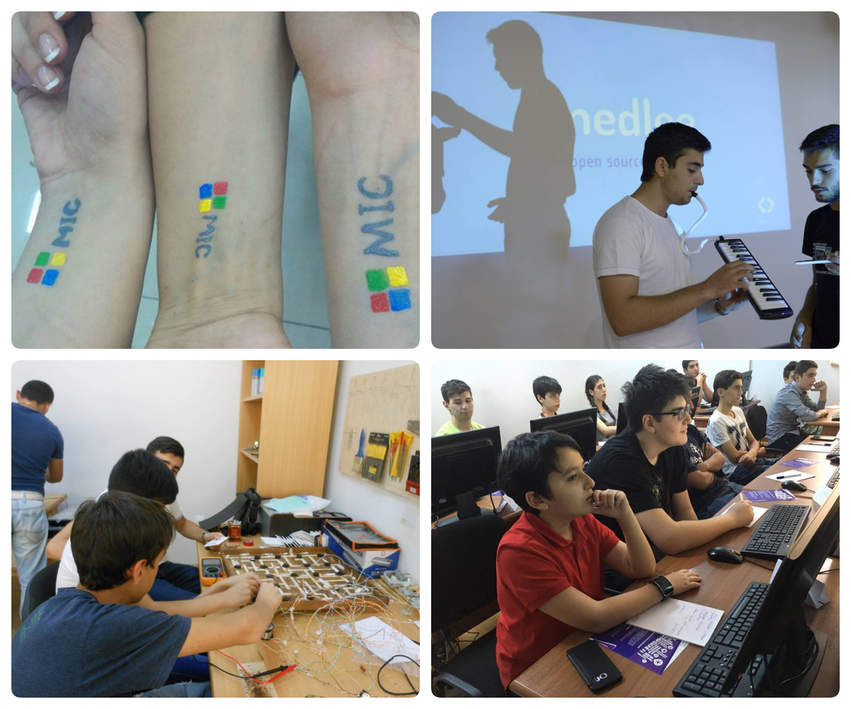
MIC/ANEL/ARMINDIA/ISTC
>5000 training participants annually in the areas of Programming, Engineering, Mobile, Business/management
Centers continue to cooperate with private sector to provide trainings based on the industry needs
More than 100 startups accelerated

Slide 14
THANK YOU!

